Slide 1
Who bears a per-unit tax?
Sellers must remit a $4 tax for every bottle sold.
Task 1: predict who bears the burden and explain why.
Our evidence will be a hypothetical market, not a vote on a real policy.
The Macs' Learning Co. | 1/10
Notes:
0-2 minutes. Distribute the six-page student handout. Take a few contrasting reasons without grading the prediction. This is a new original free-sample lesson, not an excerpt from a paid lesson. Do not reveal numeric outcomes yet.

Slide 2
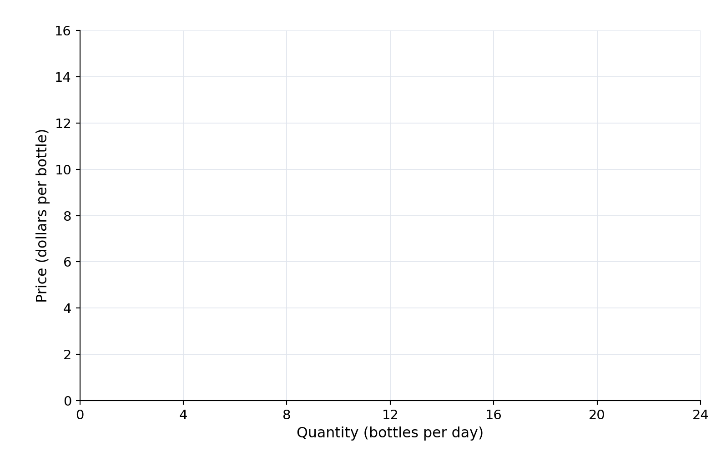
Read the model before the result
Illustrative simulated bottle-market data.
Quantity: bottles/day. Price: dollars/bottle.
Straight lines; competitive market; fully collected tax; no other policy or market failure.
Task 2: plot D and S from your table and label the original equilibrium.
The Macs' Learning Co. | 2/10
Notes:
2-9 minutes, initial work. Use the supplied table, not a guessed supply/demand sketch. Prerequisites are equilibrium, surplus, graphing, and rectangle/triangle areas. The blank axes have Q from 0 to 24 by 4 and P from 0 to 16 by 2; they contain no curve or equilibrium answer. Confirm units and curve names while circulating.

Slide 3
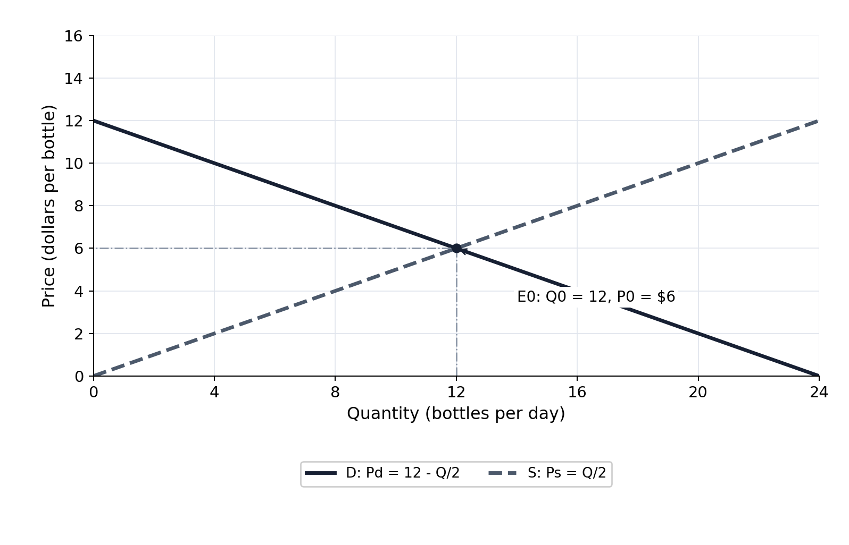
Baseline check, after your graph
Original quantity: 12 bottles/day.
Original price: $6 per bottle.
D and S meet at E0; the table prices agree there.
The Macs' Learning Co. | 3/10
Notes:
Reveal only after task 2 has been attempted, at the end of minutes 2-9. Students correct their own curves and labels. Model derivation: 12 - Q/2 = Q/2, so Q0 = 12 and P0 = 6. Preserve both curves for the tax comparison.

Slide 4
Build the $4 wedge
Task 3: add $4 to every original supply price.
Task 4: graph S + tax and locate its intersection with D.
At the new quantity, mark what buyers pay and what sellers keep.
The Macs' Learning Co. | 4/10
Notes:
9-19 minutes: task 3 for 3 minutes; task 4 for 7 minutes. Keep the next modeled graph hidden. Ask what a buyer must pay for a seller to retain the original supply price after sending $4 to government. Students work on their existing page 2 graph; this slide provides a blank projection workspace, not a demand shift.

Slide 5
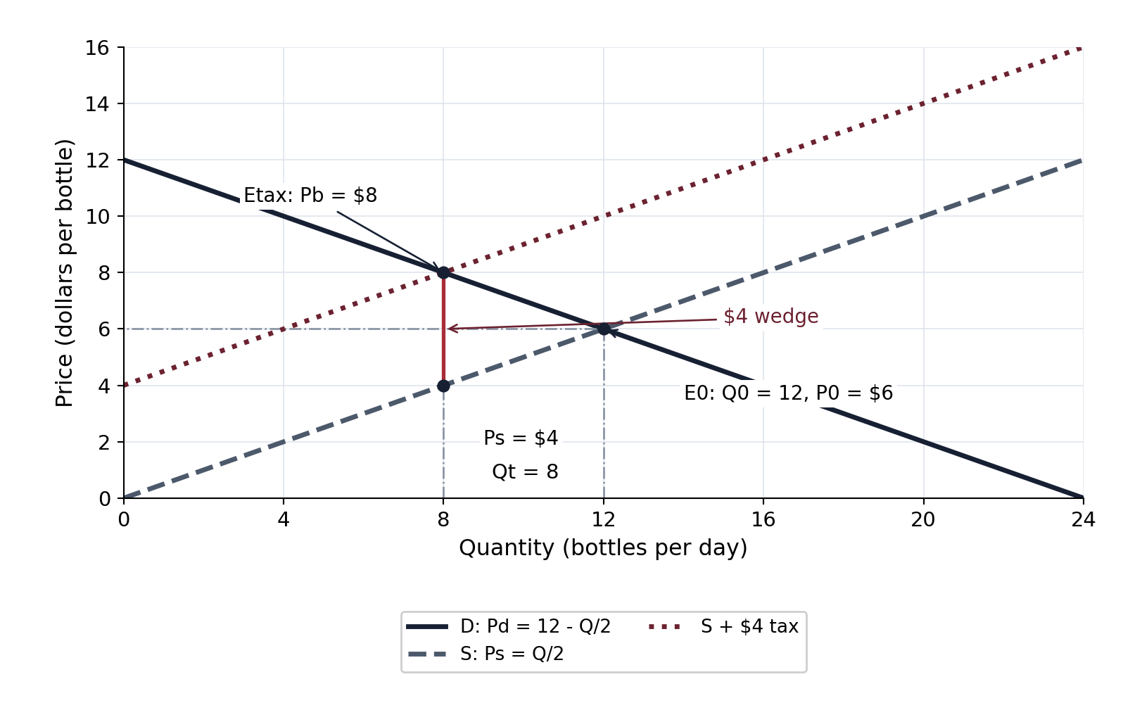
Taxed outcome, after your attempt
Quantity traded: 8 bottles/day.
Buyers pay $8; sellers retain $4 per bottle.
The vertical difference is the $4 tax.
Both prices belong to the same new quantity.
The Macs' Learning Co. | 5/10
Notes:
Reveal after tasks 3 and 4 have been attempted, at the end of minutes 9-19. Taxed asking-price schedule is 4, 6, 8, 10, 12, 14, 16. The buyer intersection is (8,8); the seller point is (8,4) on original S. Underlying D and S stay visible. Use a vertical guide at Q = 8 to prevent a mistaken seller-price location.

Slide 6
Account for traded bottles
Task 5 first: compare both prices with the original $6.
After checking: buyers bear $2 and sellers bear $2 per bottle.
Each bears $16/day on traded bottles, with a 50% share.
Per-bottle amounts and daily totals need different units.
The Macs' Learning Co. | 6/10
Notes:
19-25 minutes. Do not display the modeled numeric bullets until students have attempted task 5; use a blank screen or the preceding task prompt during work. Check (8 - 6) and (6 - 4), then multiply each by the eight traded bottles. These totals are burdens on traded bottles, not the full change in consumer or producer surplus.

Slide 7
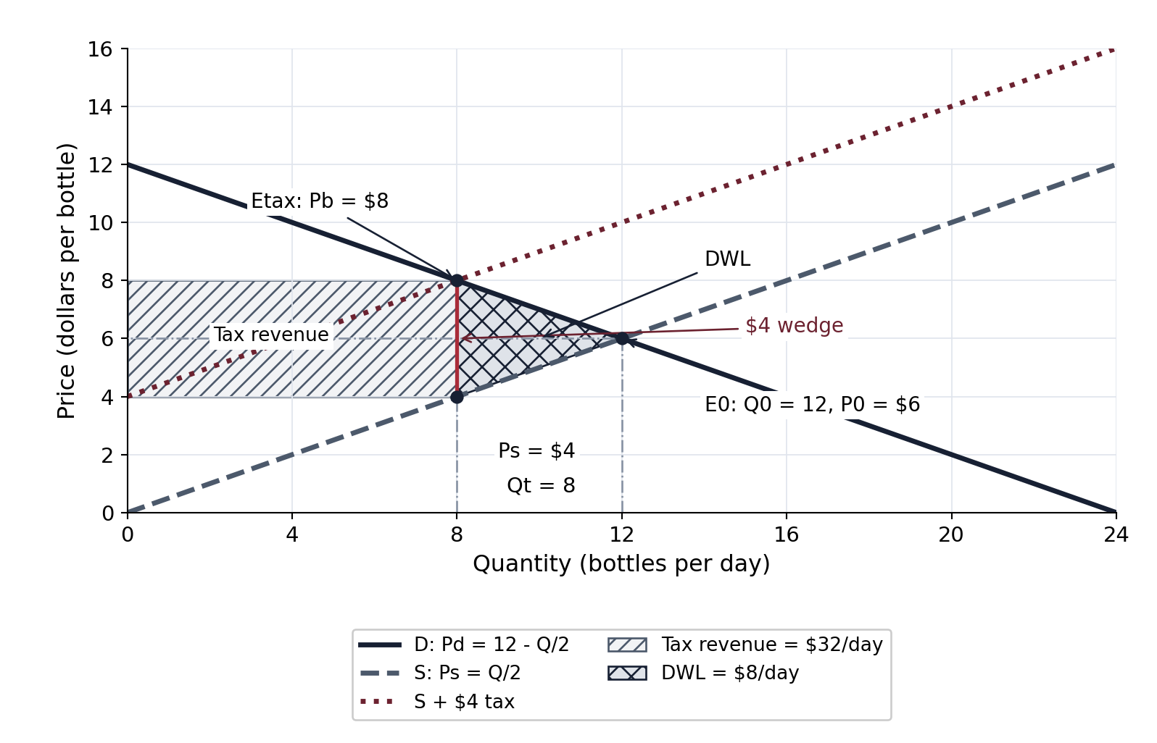
Revenue is not deadweight loss
Task 6 first: shade the rectangle and triangle with distinct patterns.
After checking: revenue = $4 × 8 = $32/day.
Deadweight loss = 1/2 × $4 × 4 = $8/day.
Four bottles/day of trades between the new and original quantities no longer occur.
The Macs' Learning Co. | 7/10
Notes:
25-31 minutes. Reveal only after task 6 is attempted. Revenue rectangle corners are (0,4), (8,4), (8,8), (0,8); DWL triangle corners are (8,4), (8,8), (12,6). The lost quantity is an interval in the continuous straight-line model; do not sum discrete endpoint values for bottles 9-12. Revenue is transferred to government; gains from the forgone interval are lost under this model's assumptions.

Slide 8
Test who sends and who bears
Task 7: evaluate the claim using Pb, Ps, and P0.
Revisit your original prediction.
Would changing the legal remitter alter incidence under the same assumptions?
The Macs' Learning Co. | 8/10
Notes:
31-35 minutes. Students commit an explanation before the teacher debrief. Correct conclusion: sellers remit the tax, but both groups bear $2 per bottle. A buyer-remitted $4 tax gives the same wedge and outcome in this fixed-curve competitive model. This is not a claim about all real-world enforcement or collection costs.

Slide 9
Transfer to another market
Task 8: compare price responsiveness in percentage terms.
Demand is less responsive than supply in the new market.
Explain which side would bear more; a line's slope alone is not a universal elasticity measure.
The Macs' Learning Co. | 9/10
Notes:
35-37 minutes. Allow students to respond before debriefing. Buyers bear more when demand is relatively less elastic: they adjust quantity less readily. The equal shares in today's bottle model are a result of its specified schedules, not a universal rule. Frame the explanation around relative responsiveness, not how steep a drawing appears.

Slide 10
Exit: four independent checks
Complete tasks 9-12 on the exit page.
Select one answer for each item; use your own graph and accounting.
Check quantity, seller receipt, tax revenue, and relative responsiveness.
The Macs' Learning Co. | 10/10
Notes:
37-40 minutes. Hide answer-bearing slides. Collect individual responses before releasing answers. Teacher-only key: 9 B, 10 D, 11 A, 12 C. Read each misconception separately rather than treating four items as a broad AP-readiness score. Reference: official AP Microeconomics CED effective Fall 2026, Topic 2.8, printed p.55/PDF p.62, skill 4.C.

